Slide 1




2023

Slide 2
X++ Extreme: Boost Your Development Skills with Proven Tips and Tricks

Slide 3

Nathan Clouse
Technical Architect enVista Corp.
Microsoft Business Applications MVP (4x)
nclouse@envistacorp.com
www.atomicax.com
www.dynamics.fo
@NathanClouseAX

Slide 4

Peter Ramer
Director of Managed Application Services RSM
Microsoft Business Applications MVP (2x)
www.dynamics365musings.com

Slide 5
Coding Tips
D365FO.Tools
Quality of Life Hacks
Debugging
Visual Studio Hidden

Slide 6
Coding Tips

Slide 7

Use Set Based Operations
Update_recordset rather than while select w/ update
RecordInsertList rather looped inserts
RecordInsertList rather than insert_recordset
Delete_from rather than while select update

Slide 8

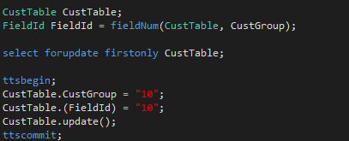
Using FieldNum Ordinals
Standard: CustTable.AccountNum
Using Ordinals: CustTable.(fieldNum(CustTable,AccountNum))

Slide 9
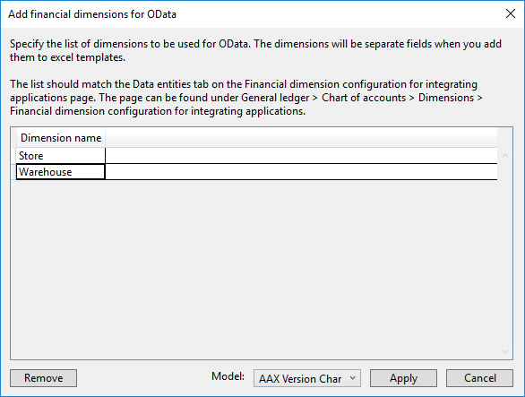

Add Financial Dimension for OData
Dynamics 365 > Addins > Add financial dimensions for OData

Slide 10

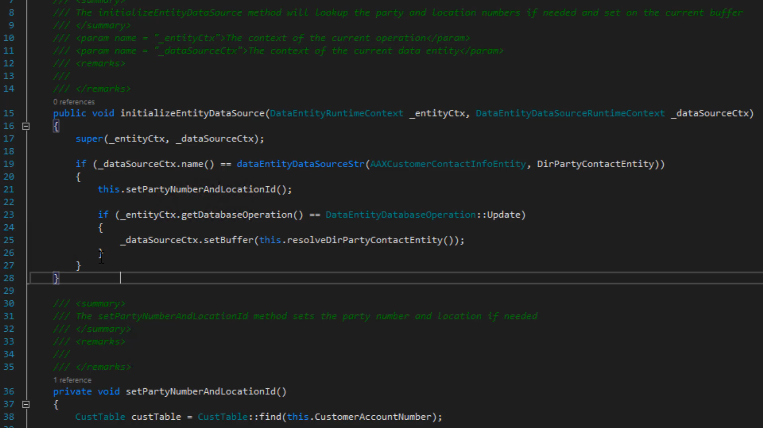
Comment Code
CTRL K, CTRL U

Slide 11

Uncomment Code
CTRL K, CTRL U

Slide 12
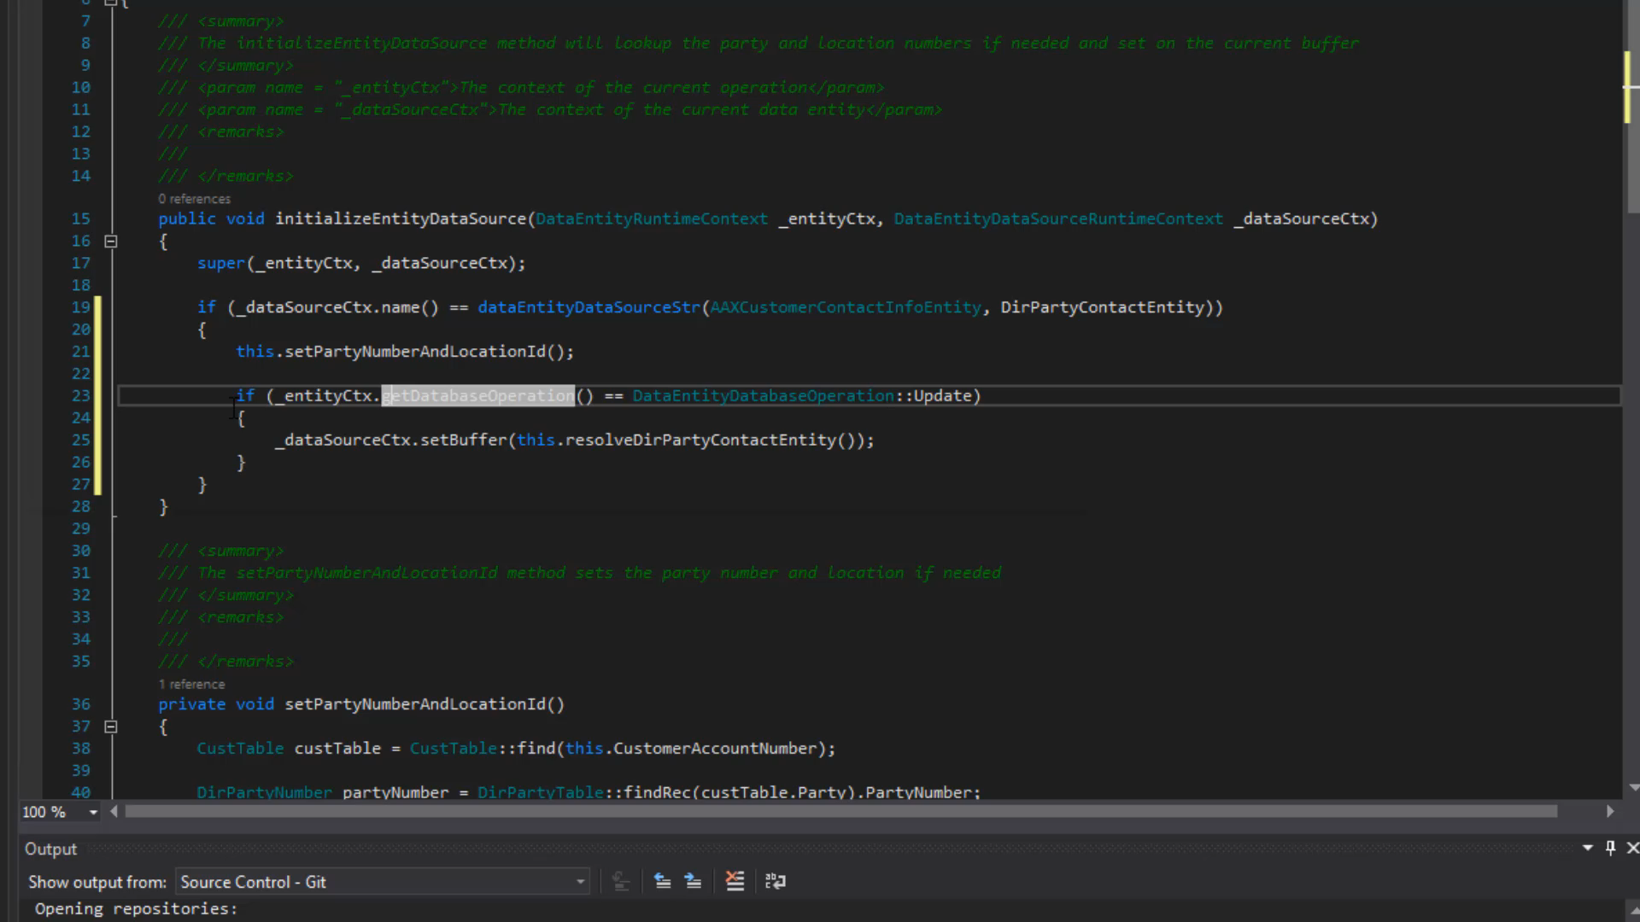

Format Code
CTRL K , D

Slide 13
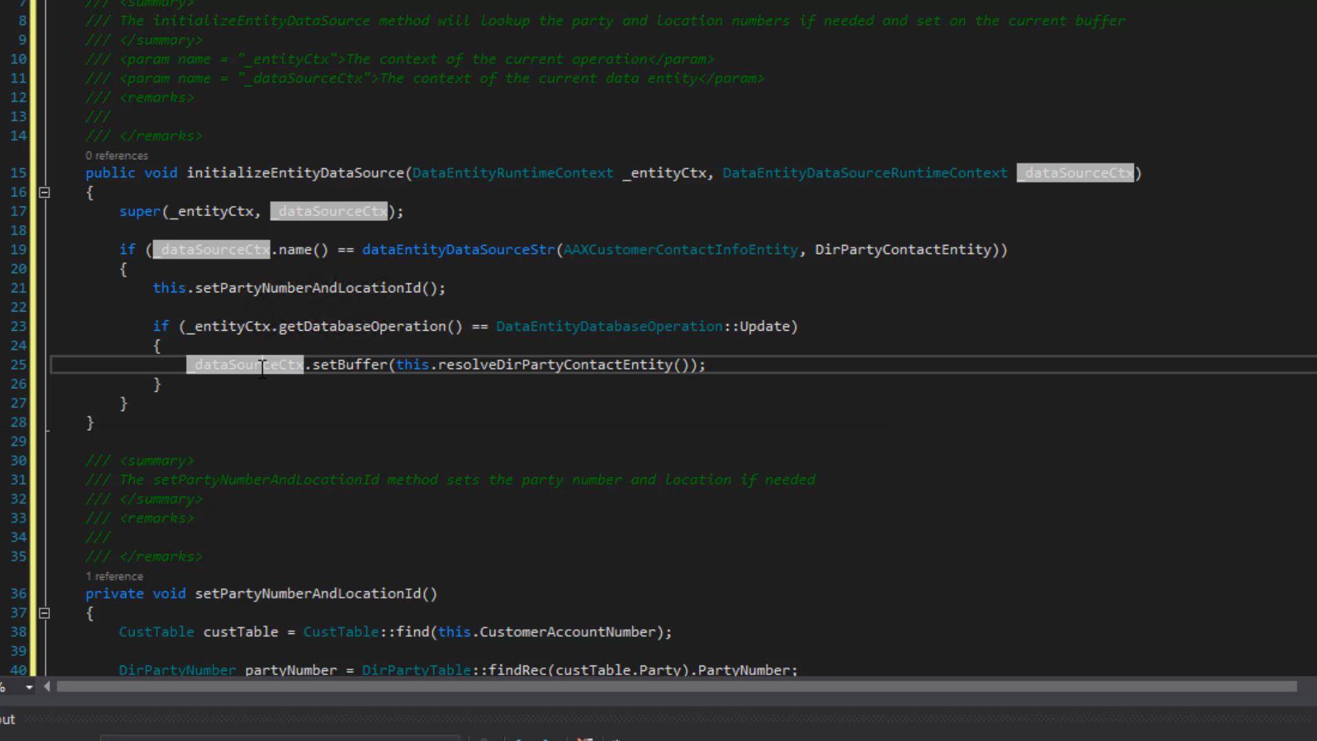

Toggle Breakpoints
F9

Slide 14

Go To (Main Thing)
Hit F9 in design view to go to the main thing for the item selected
F9 on a table extension will take you to the base table
F9 on a field will take you to the EDT
F9 on a field with a relationship will take you to the related table
F9 on a field in a data entity will open the table/entity for that field
F9 on COC Extension Class will take you to the main class

Slide 15

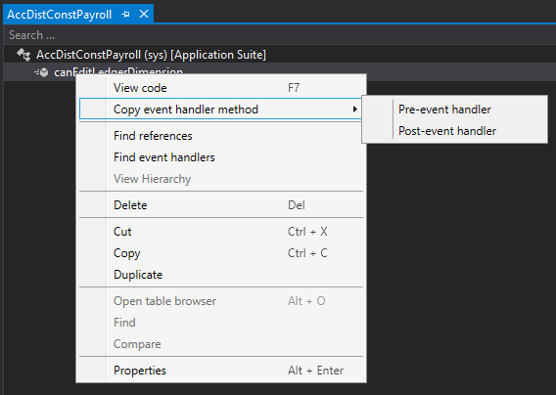
Copy Event Handlers - Methods
In design view, expand methods, right click, copy event handler

Slide 16

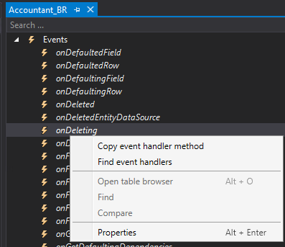
Copy Event Handler - Events
In design view, expand events, right click, copy event handler

Slide 17
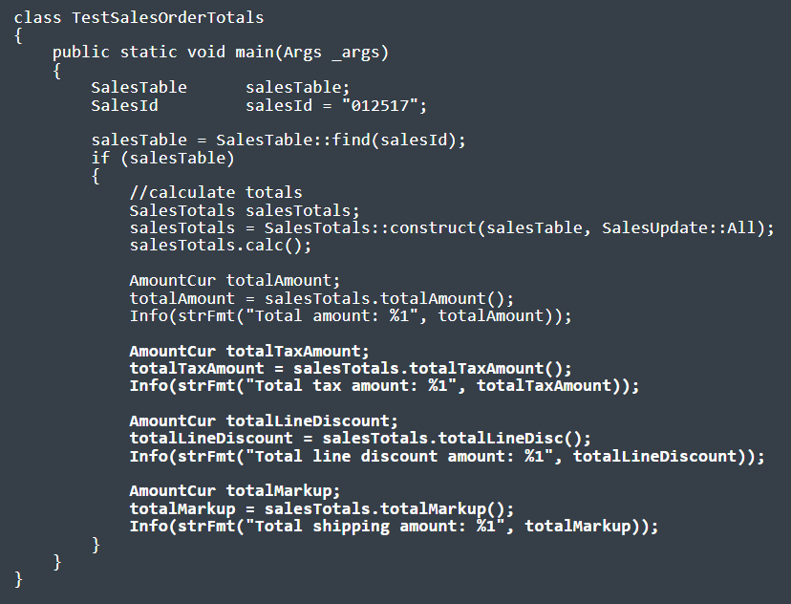

Sales order Totals
https://dynamics365musings.com/d365-sales-order-totals/

Slide 18

Extensible Controls
https://www.youtube.com/watch?v=QrIjTN6Vey4&t=149s
https://sangeethwiki.blogspot.com/2017/09/extensible-controls-in-dynamics-365-for.html
Use Javascript and html to create your own D365 controls.

Slide 19

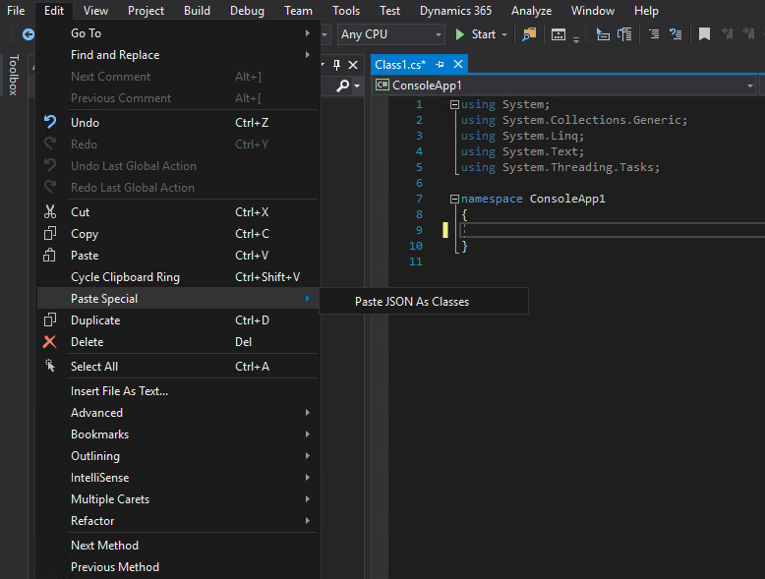
Paste Special
Edit > Paste Special
XML as Class
JSON as Class

Slide 20

Paste Special
{"menu": {
"id": "file",
"value": "File",
"popup": {
"menuitem": [
{"value": "New", "onclick": "CreateNewDoc()"},
{"value": "Open", "onclick": "OpenDoc()"},
{"value": "Close", "onclick": "CloseDoc()"}
]
}
}}
public class Menu
{
public string id { get; set; }
public string value { get; set; }
public Popup popup { get; set; }
}
public class Popup
{
public Menuitem[] menuitem { get; set; }
}
public class Menuitem
{
public string value { get; set; }
public string onclick { get; set; }
}

Slide 21

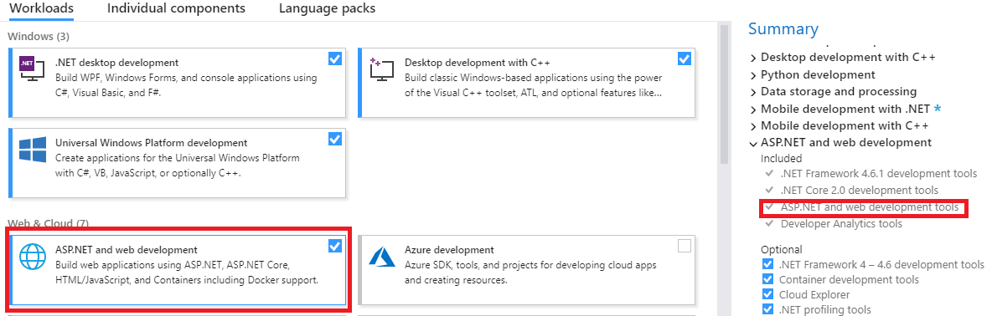
If XML Option Missing…
Add ASP.NET to VS

Slide 22

CrossCompany
static void JobDemoCrossCompany(Args _args)
{
BankAccountTable tabBAT; // saveDataPerCompany == true.
container conCompanies = [ 'cm1', 'cm2', 'dat' ];
str 4 sCompanyPrevious = " "; // Maximum length is 4 characters.
int iCountCompanies = 0;
;
while select
crossCompany
: conCompanies
* from tabBAT
order by dataAreaId
{
if ( sCompanyPrevious != tabBAT.dataAreaId )
{
info( tabBAT.dataAreaId + " = tabBAT.dataAreaId" );
iCountCompanies++;
if ( iCountCompanies >= 2 )
{
break;
}
sCompanyPrevious = tabBAT.dataAreaId;
}
}
return;
}

Slide 23
CrossCompany
BankAccountTable tabBAT; // saveDataPerCompany == true.
container conCompanies = [ 'cm1', 'cm2', 'dat' ];
str 4 sCompanyPrevious = " "; // Maximum length is 4 characters.
int iCountCompanies = 0;
;
while select
crossCompany
: conCompanies
* from tabBAT
order by dataAreaId
{
…
}
return;
}

Slide 24

CrossCompany Queries
static void JobDemoAllowCrossCompany(Args _args)
{
BankAccountTable tabBAT; // saveDataPerCompany == true.
Query qry2;
QueryBuildDataSource qbds3;
QueryRun qrun4;
str sCompanyPrevious = " ";
int iCountCompanies = 0;
int iTableNumBAT;
;
qry2 = new Query();
qry2.allowCrossCompany( true );
qry2.addCompanyRange( 'dat' );
qry2.addCompanyRange( 'twf' );
iTableNumBAT = tableNum( BankAccountTable );
qbds3 = qry2 .addDataSource( iTableNumBAT );
//qbds3.company( 'dat' );
qrun4 = new QueryRun( qry2 );
while ( qrun4.next() )
{
if ( qrun4.changed( iTableNumBAT ) )
{
tabBAT = qrun4.get( iTableNumBAT );
if ( sCompanyPrevious != tabBAT.dataAreaId )
{
print( tabBAT.dataAreaId + " = tabBAT.dataAreaId" );
iCountCompanies++;
if ( iCountCompanies >= 2 )
{
break;
}
sCompanyPrevious = tabBAT.dataAreaId;
}
}
}
pause;
return;
}

Slide 25
CrossCompany Queries
BankAccountTable tabBAT; // saveDataPerCompany == true.
Query qry2;
QueryBuildDataSource qbds3;
QueryRun qrun4;
str sCompanyPrevious = " ";
int iCountCompanies = 0;
int iTableNumBAT;
;
qry2 = new Query();
qry2.allowCrossCompany( true );
qry2.addCompanyRange( 'dat' );
qry2.addCompanyRange( 'twf' );

Slide 26

RunAsPermission
public static container download(container _parms)
{
RunAsPermission perm;
perm = new RunAsPermission("Admin");
perm.assert();
Container returncontainer = runAs("Admin", classnum(AcxSharepointIntegeration), "get", _parms);
CodeAccessPermission::revertAssert();
return returncontainer;
}
Notes:
https://allaboutdynamic.com/2020/07/07/runas-function-method-in-dynamics-365-finance-operations/

Slide 27

StrKeep
str Mobile = "712,3456789";
if (strLen(strRem(Mobile, ",")) != strLen(strKeep(strRem(Mobile, ","), "1234567890")))
{ throw error("Invalid Mobile Number"); }
else
{ info("Valid Mobile Number"); }
Notes:
https://allaboutdynamic.com/

Slide 28

StrRFix and StrLFix
static void testZeroPadding(Args _args)
{
int i = 1;
str padded;
str finalResult;
;
// Create a string, with a length of 5, ending with the value of i and padded with zeros
padded = strRFix(int2str(i), 5, "0");
finalResult = strFmt("ABC-%1", padded);
// 00001
}

Slide 29

Use C#
X++ is good but what it can’t do, C# can do
Call an external web service
Handle JSON/XML tedium
FTP

Slide 30
Use C#
class AAX_AzureQueueTest { const str connectionString = "Endpoint=sb://[urlName]servicebus.windows.net/;SharedAccessKeyName=[SharedAccessName];SharedAccessKey=[SharedAccessKey]=;EntityPath=[QueueName]"; public static void main(Args args) { AAX_AzureQueueLibrary.ReceiveAzureQueue ReceiveAzureQueue = new AAX_AzureQueueLibrary.ReceiveAzureQueue(); AAX_AzureQueueLibrary.SendAzureQueue SendAzureQueue = new AAX_AzureQueueLibrary.SendAzureQueue();
//x++ get a guid, not C# str s = "Test Message " + WinAPIServer::createGUID();
SendAzureQueue.connect(connectionString); SendAzureQueue.sendMessage(s); SendAzureQueue.close();
info(strFmt("sent: %1", s)); s = "";
ReceiveAzureQueue.connect(connectionString);
s = ReceiveAzureQueue.readMessage();
ReceiveAzureQueue.completeMessage();
ReceiveAzureQueue.close();
info(strFmt("Received: %1", s));
}
}

Slide 31

Other Stuff
Can’t locate an error that is being thrown? Add a breakpoint in info.Add() (on switch (logLevel))
Use funcName() to help with figuring problems out
QueryBuildDataSource.toString() to see the SQL for a query
Data Entities can be temperamental; DB Sync, delete entity (from Data Entity Screen), rebuild list, test again

Slide 32
D365FO.Tools

Slide 33

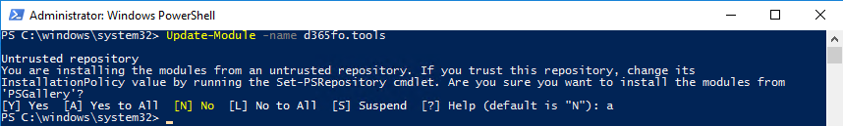
D365FO.Tools
PowerShell module to handle the different management tasks during a Dynamics 365 Finance & Operations
Install-Module -Name d365fo.tools
Update-Module -name d365fo.tools

Slide 34

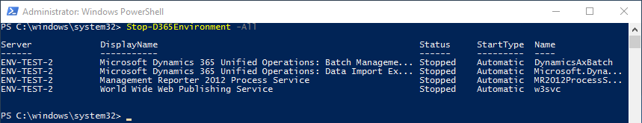
Stop An Environment
Stop-D365Environment -All
Stop-D365Environment -Aos -Batch
Stop-D365Environment -FinancialReporter -DMF
Stop-D365Environment -All -Kill

Slide 35

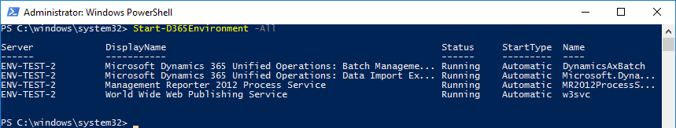
Start An Environment
Start-D365Environment -ShowOriginalProgress
Start-D365Environment -All
Start-D365Environment -Aos -Batch
Start-D365Environment -FinancialReporter -DMF

Slide 36
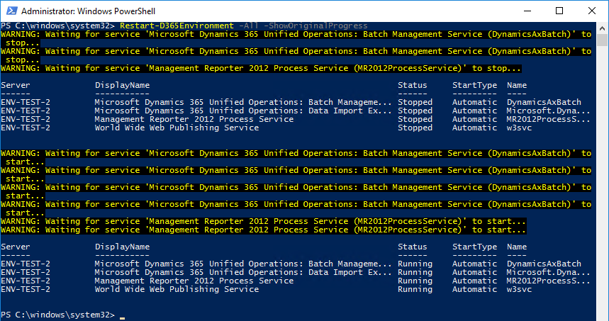

Restart
Restart-D365Environment -All -ShowOriginalProgress

Slide 37

(Re)Set D365FO Admin
Set-D365Admin "claire@contoso.com"

Slide 38

Export Database from Sandbox
Invoke-D365LcsDatabaseExport -ProjectId 123456789 -SourceEnvironmentId "958ae597-f089-4811-abbd-c1190917eaae" -BackupName "BackupViaApi" -BearerToken "JldjfafLJdfjlfsalfd..." -LcsApiUri "https://lcsapi.lcs.dynamics.com"
Notes:
https://blog.simonw.se/getting-an-access-token-for-azuread-using-powershell-and-device-login-flow/

Slide 39

Refresh Database (Prod To Sandbox)
Invoke-D365LcsDatabaseRefresh -ProjectId 123456789 -SourceEnvironmentId "958ae597-f089-4811-abbd-c1190917eaae" -TargetEnvironmentId "13cc7700-c13b-4ea3-81cd-2d26fa72ec5e" -BearerToken "JldjfafLJdfjlfsalfd..." -LcsApiUri "https://lcsapi.lcs.dynamics.com"
Notes:
https://blog.simonw.se/getting-an-access-token-for-azuread-using-powershell-and-device-login-flow/

Slide 40

Sync Database for Module(s)
Invoke-D365DbSyncModule -Module "MyModel1"
Invoke-D365DbSyncModule -Module "MyModel1","MyModel2"
Get-D365Module -Name "MyModel*" | Invoke-D365DbSyncModule

Slide 41

Partial DB Sync
Invoke-D365DBSyncPartial -SyncList "CustCustomerEntity","SalesTable"
Invoke-D365DBSyncPartial -SyncList "CustCustomerEntity","SalesTable" -Verbose

Slide 42
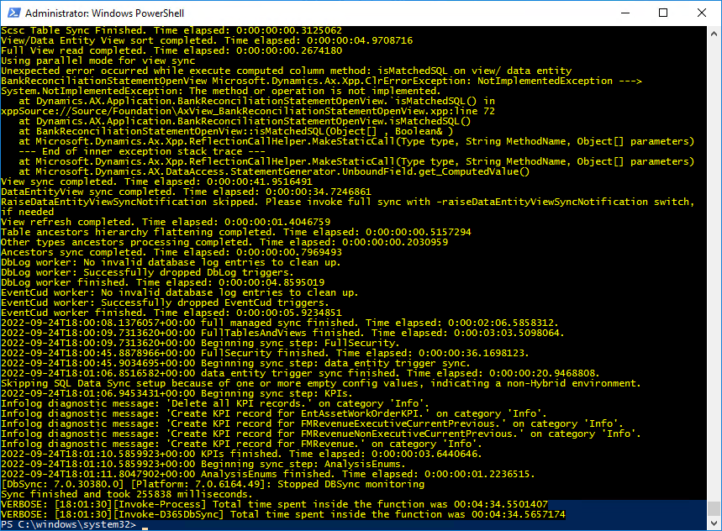

DB Sync
Invoke-D365DBSync
Invoke-D365DBSync -Verbose

Slide 43
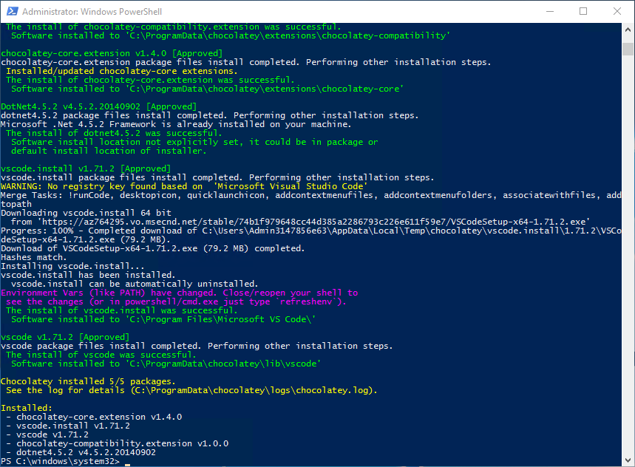

Install Supporting Software
Install-D365SupportingSoftware -Name vscode
Install-D365SupportingSoftware -Name "vscode","fiddler"
Install-D365SupportingSoftware -Name googlechrome

Slide 44
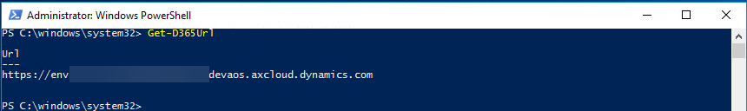

Getting Environment URL
Get-D365Url

Slide 45

Searching for an AOT Object
Get-D365AOTObject -Name *flush* -ObjectType AxClass -Path "C:\AOSService\PackagesLocalDirectory\ApplicationFoundation"
Get-D365AOTObject -Name *flush* -ObjectType AxClass -IncludePath -Path "C:\AOSService\PackagesLocalDirectory\ApplicationFoundation"
Get-D365InstalledPackage -Name Application* | Get-D365AOTObject -Name *flush* -ObjectType AxClass
Get-D365AOTObject -Path "C:\AOSService\PackagesLocalDirectory\*" -Name *flush* -ObjectType AxClass -SearchInPackages

Slide 46
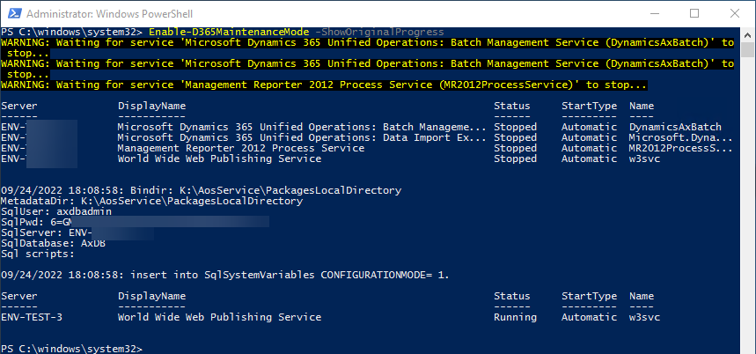

Maintenance Mode
Enable-D365MaintenanceMode -ShowOriginalProgress
Disable-D365MaintenanceMode -ShowOriginalProgress

Slide 47

Import Database into Dev (T1)
Invoke-D365InstallSqlPackage
Import-D365Bacpac -ImportModeTier1 -BacpacFile "C:\temp\uat.bacpac" -NewDatabaseName "ImportedDatabase_YYYYMMDD"

Slide 48

Export Database from Dev (T1)
New-D365Bacpac -ExportModeTier1 -BackupDirectory c:\Temp\backup\ -NewDatabaseName Testing1 -BacpacFile "C:\Temp\Bacpac\Testing1.bacpac"

Slide 49
Quality Of Life

Slide 50

Copy data from excel to D365 grid
https://learn.microsoft.com/en-us/dynamics365/fin-ops-core/fin-ops/get-started/grid-capabilities
Just copy and paste.
Plus, lots of other features (Enabled in Feature Management)

Slide 51

Table Browser
https://dynamics365musings.com/d365-table-browser/
https://<environmentURL>/?mi=SysTableBrowser&tablename=<tablename>

Slide 52
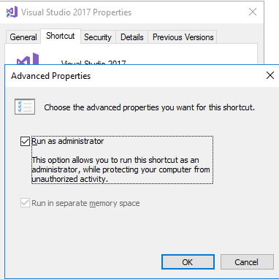

Run VS as Admin
Start
Search for Visual Studio 2019
Right click > Open file location
Find icon, right click > Properties > Advanced
Check “Run As Administrator”

Slide 53
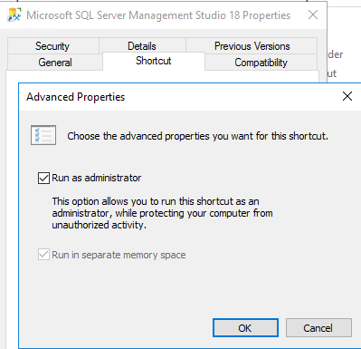

Run SSMS as Admin
Nearly the same as for VS 2019

Slide 54
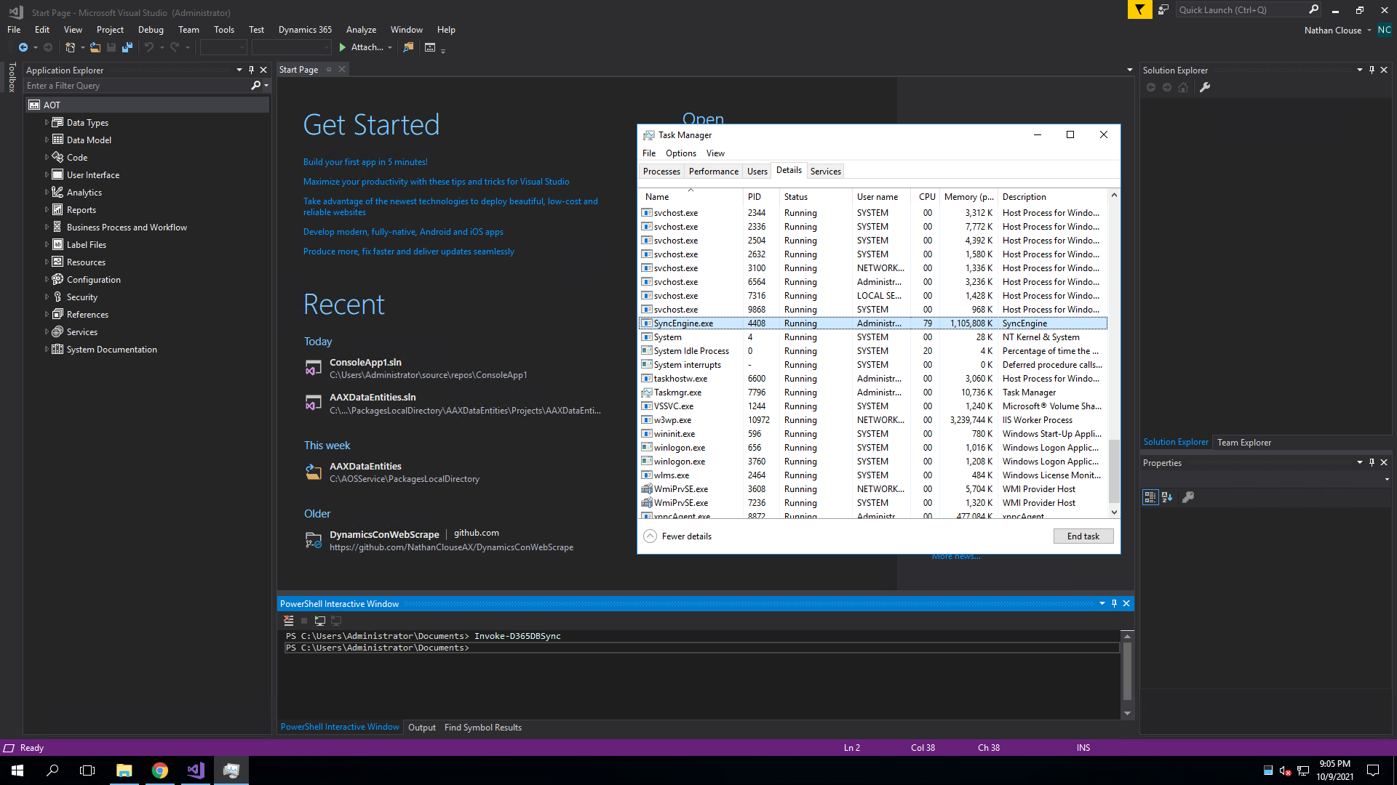

Run D365FO.Tools in VS
Run PowerShell from VS
Like D365FO.Tools
Notes:
http://www.atomicax.com/article/d365fotools-and-vs2017-manhattan-project

Slide 55

Notes:
http://www.atomicax.com/article/d365fotools-and-vs2017-manhattan-project

Slide 56

Run D365FO.Tools in VS
Run PowerShell from VS
Like D365FO.Tools
Notes:
http://www.atomicax.com/article/d365fotools-and-vs2017-manhattan-project

Slide 57


Plus Aliases
Use notepad $profile

Slide 59

Querying in SQL w/ nolock
Using NOLOCK when directly querying SQL can show uncommitted records
Useful when debugging
I.e.: SELECT * FROM SalesTable WITH (nolock) WHERE SalesId = ‘SO04381969’
AND DataAreaId = ‘USMF’

Slide 60
Debugging

Slide 61
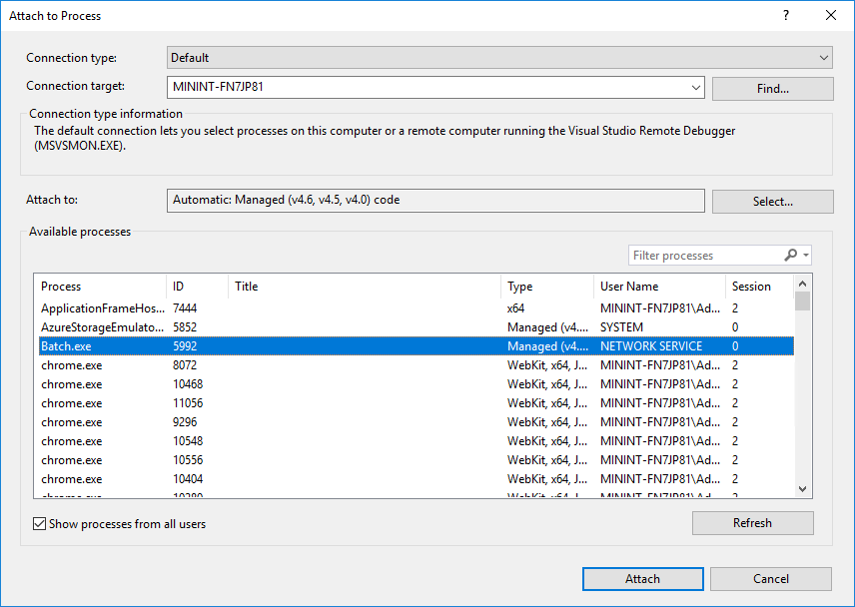

Debugging Batch Jobs
Attached to process
Show all processes from all users
Look for Batch.exe

Slide 62

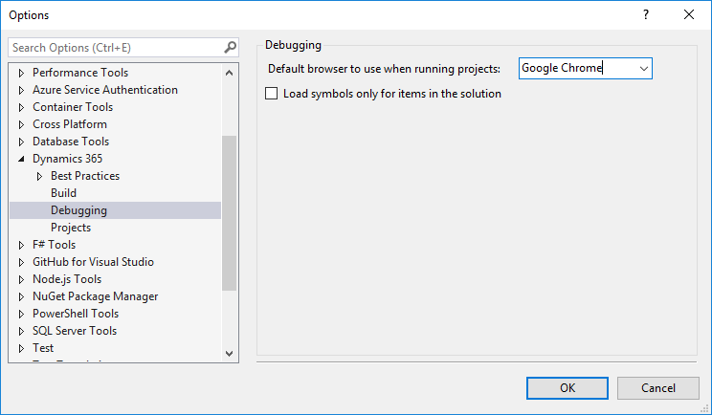
Loading Symbols
Tools > Options

Slide 63
Loading Symbols

Slide 64
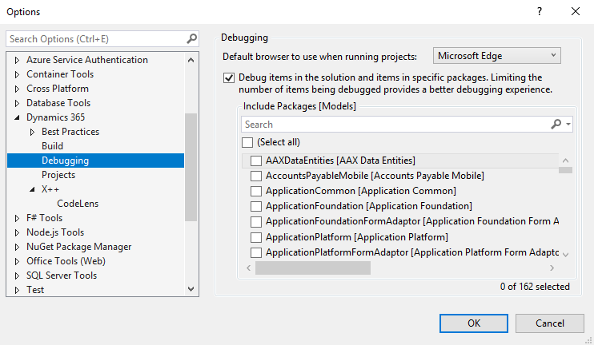
Loading Symbols

Slide 65
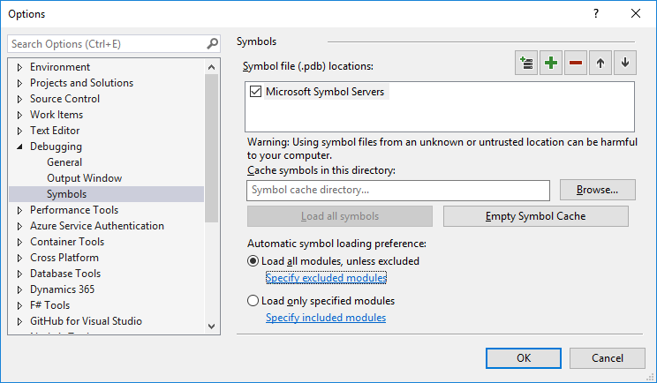
Load all modules

Slide 66
Visual Studio Hidden Gems

Slide 67
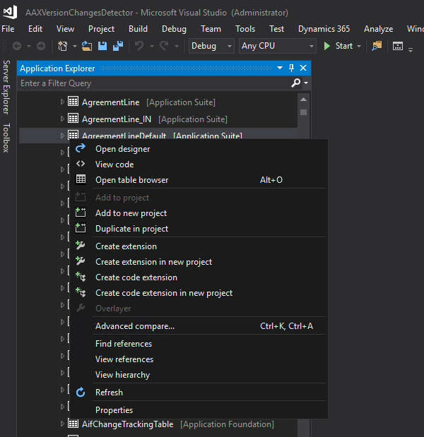

Create code extension
Create code extension

Slide 68
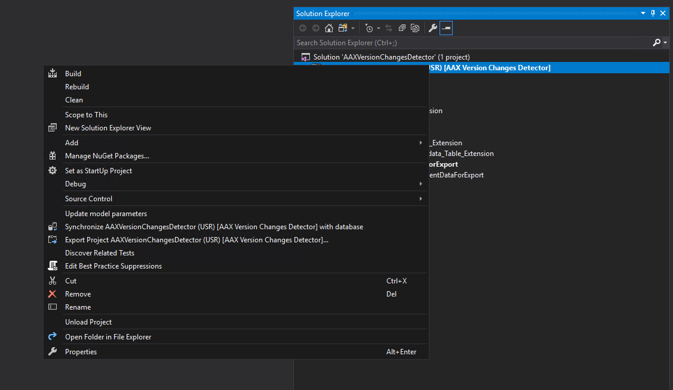

Update Model Parameters
Update model parameters

Slide 69
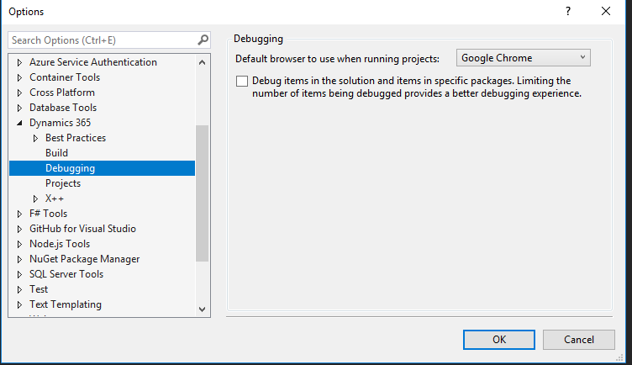

Debug items in solution

Slide 70
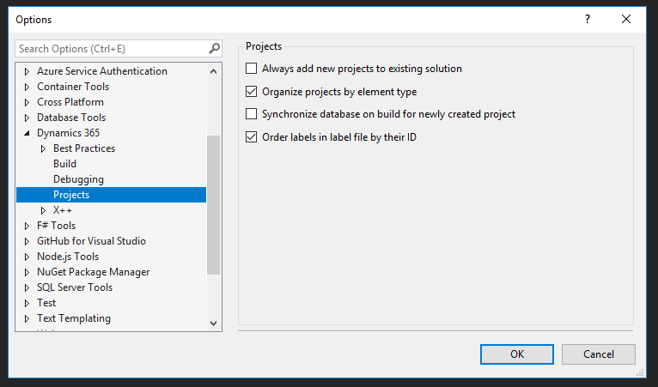

Order Labels in label file by ID

Slide 71
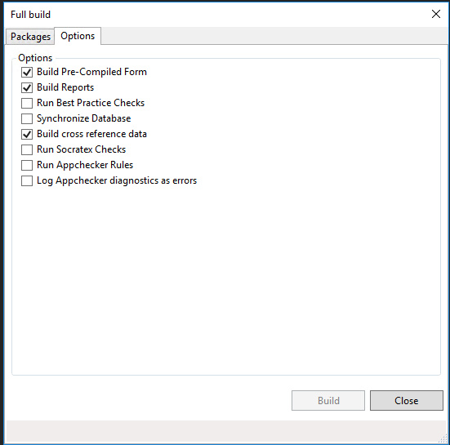

Build Options

Slide 72
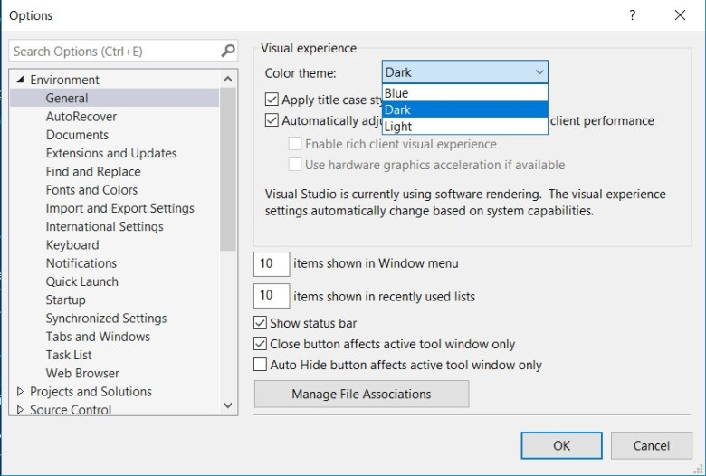

Dark Mode Plus Custom Colors
Notes:
https://jatomas.com/en/2020/05/02/dark-mode-visual-studio-x-code-editor/

Slide 73
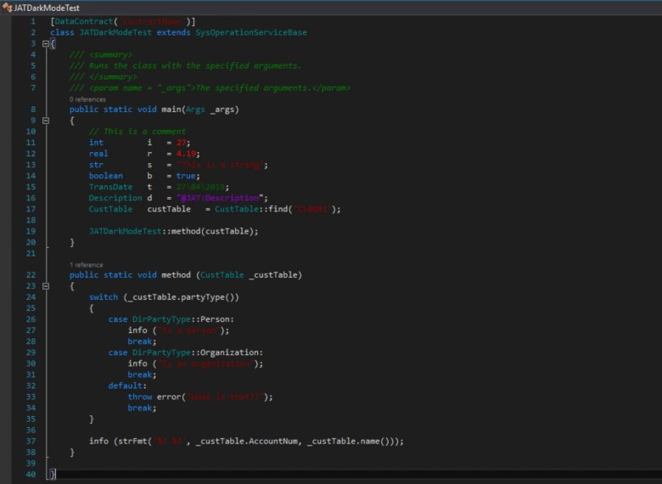
Notes:
https://jatomas.com/en/2020/05/02/dark-mode-visual-studio-x-code-editor/

Slide 74
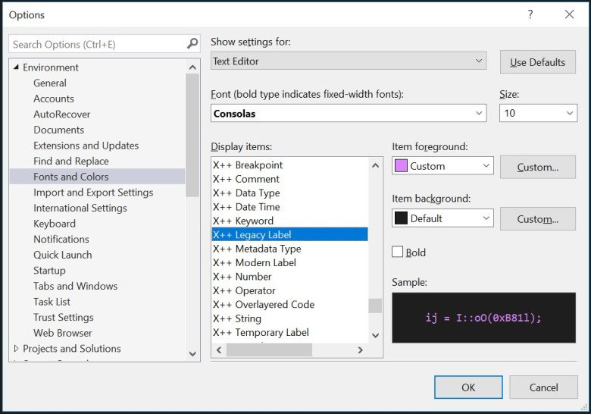

Dark Mode Plus Custom Colors
Notes:
https://jatomas.com/en/2020/05/02/dark-mode-visual-studio-x-code-editor/

Slide 75
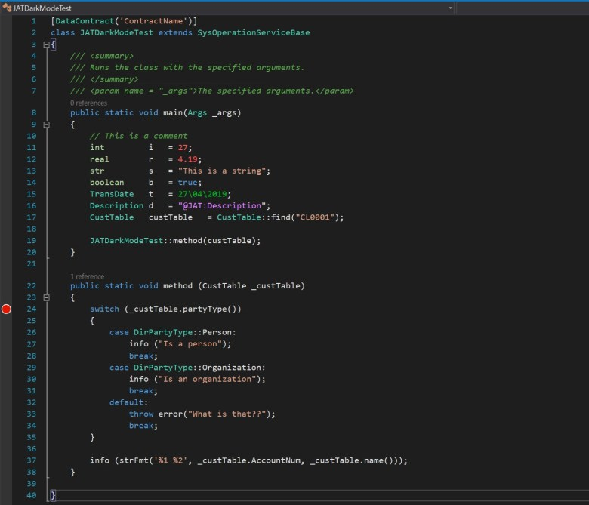
Notes:
https://jatomas.com/en/2020/05/02/dark-mode-visual-studio-x-code-editor/

Slide 76
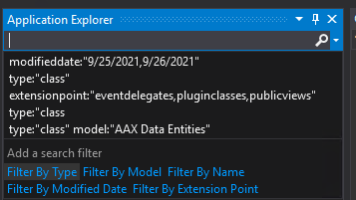

Metadata Search
Search on any option, value, metadata, whatever, on an element
type:"form" ccount
type:"class" extensionpoint:"eventhandlers,eventdelegates"

Slide 77

Metadata Search
type:"dataentityview" property:"PublicCollectionName=CustomerStatisticsGroups"
type:"dataentityview" property:"PublicEntityName=CustomerStatisticsGroup"

Slide 78

TRUDUtilsD365
Open Source
https://github.com/TrudAX/TRUDUtilsD365
Prototyping Tools that help with productivity
Configurable
Similar idea from AX 2009/2012 with configurable MorphX tools

Slide 79
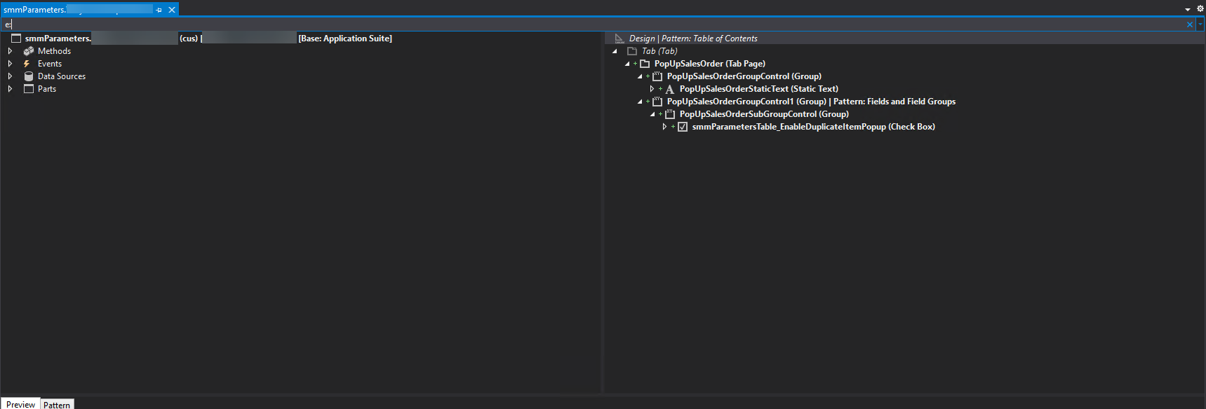
VS E: on Form Extensions

Slide 80
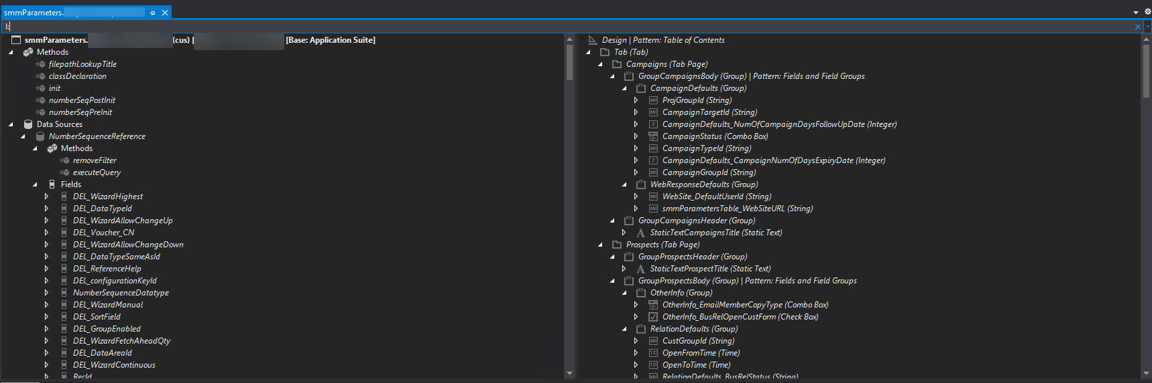
VS L: on Form Extensions

Slide 81
Resources
http://www.atomicax.com/article/d365fotools-and-vs2017-manhattan-project
https://docs.microsoft.com/en-us/dynamics365/fin-ops-core/dev-itpro/dev-ref/xpp-business-run-time-functions
https://docs.microsoft.com/en-us/dynamics365/fin-ops-core/dev-itpro/dev-ref/xpp-string-run-time-functions
https://jatomas.com/en/2020/05/02/dark-mode-visual-studio-x-code-editor/
https://dynamics365musings.com/d365-sales-order-totals/
https://www.youtube.com/watch?v=QrIjTN6Vey4&t=149s
https://sangeethwiki.blogspot.com/2017/09/extensible-controls-in-dynamics-365-for.html

Slide 82
Resources
https://ariste.info/en/2021/06/socratex-application-checker/
https://github.com/TrudAX/TRUDUtilsD365

Slide 83
Questions?

Slide 84
Thanks!
Nathan Clouse
nclouse@envistacorp.com
www.atomicax.com
www.dynamics.fo
@NathanClouseAX
https://www.linkedin.com/in/nathanclouseax/
Peter Ramer
www.dynamics365musings.com
https://www.linkedin.com/in/peter-ramer/

Slide 86

© 2023 Dynamic Communities. All rights reserved.

